Slide 1
Redistribution and Equilibrium Work
Chicago Price Theory

Slide 2
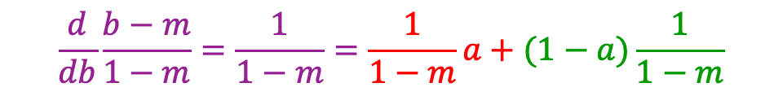
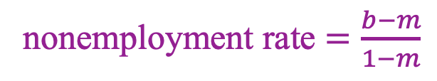
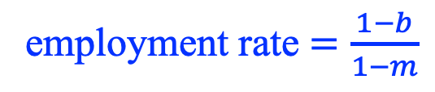
Seasonal/cyclical employment
Surplus from work
1
Separation
Hire
Separation
Hire
b
m
employment rate $=\frac{1−b}{1−m}$
nonemployment rate $=\frac{b−m}{1−m}$
$$\frac{d}{db}\frac{b−m}{1−m}=\frac{1}{1−m}=\frac{1}{1−m}a+(1−a)\frac{1}{1−m}$$
Time
0
a
1
1+a

Slide 3
Seasonal/cyclical employment
Surplus from work
Separation
Hire
Separation
1
b
m
$$\frac{d}{db}\frac{b−m}{1−m}=\frac{1}{1−m}=\frac{1}{1−m}a+(1−a)\frac{1}{1−m}$$
Time
0
a
1

Slide 4
Layoff subsidies, according to “businessmen”
Urban Institute survey of employers
“Some large‐firm interviewees reported that before ARRA. they provided some amount of free or reduced cost Cobra coverage for laid‐off workers….”
“Several of these companies reported that they reduced or dropped this prior benefit in reaction to A.R.R.A.”
--> employers understood that the ARRA subsidized layoffs
[ARRA = American Recovery and Reinvestment Act]
Notes:
4

Slide 5


Slide 6
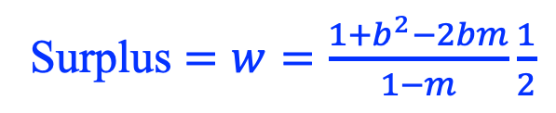
Acyclical employment
Surplus from work
w
bw
Surplus $=w=\frac{1+b^{2}−2bm}{1−m}\frac{1}{2}$
Seasonal surplus (RHS) is increasing and convex in b
Time
0
1

Slide 7
Five substitution margins
Exit unemployment later
  Practically all the empirical work is here
Exit employment earlier
Intra-industry factor substitution
  i.e., seasonal industry increases labor intensity
Inter-industry output substitution
  Seasonal industry grows while aseasonal industry shrinks
Reduced frictions/increased takeup
  Incentive to acquire information about the benefit system
  Reduced stigma

Slide 8
Summarizing a complex tax-benefit system
Work disincentives are present in tax rules
  Taxes on payroll or earnings
  Taxes on employment or full-time employment
Work disincentives are present in benefit rules
Tax and benefit rules vary by demographics
  Family characteristics
  Occupation, etc.
Price index approach: define the “average disincentive” as the “inflation” in the reward to work that would occur by removing disincentives

Slide 9

Tax-benefit system notation
Index worker types. Workers of the same type have the same disincentive.
Type i employer cost is w_{i}
Type i employee benefit from work is (1⎯𝛕_{i})w_{i}
  E.g., unemployment benefit b_{i}: 𝛕_{i} = b_{i}/w_{i}
  E.g., payroll tax at rate t_{i} and unemployment benefit b_{i}: 𝛕_{i} = t_{i} + b_{i}/w_{i}
How would employer cost be different if employers paid (1⎯𝛕_{i})w_{i} rather than w_{i} ?
$$\frac{c\left(\left(1−τ_{1}\right)w_{1},\left(1−τ_{2}\right)w_{2},…;L\right)}{c\left(w_{1},w_{2},…;L\right)}$$

Slide 10

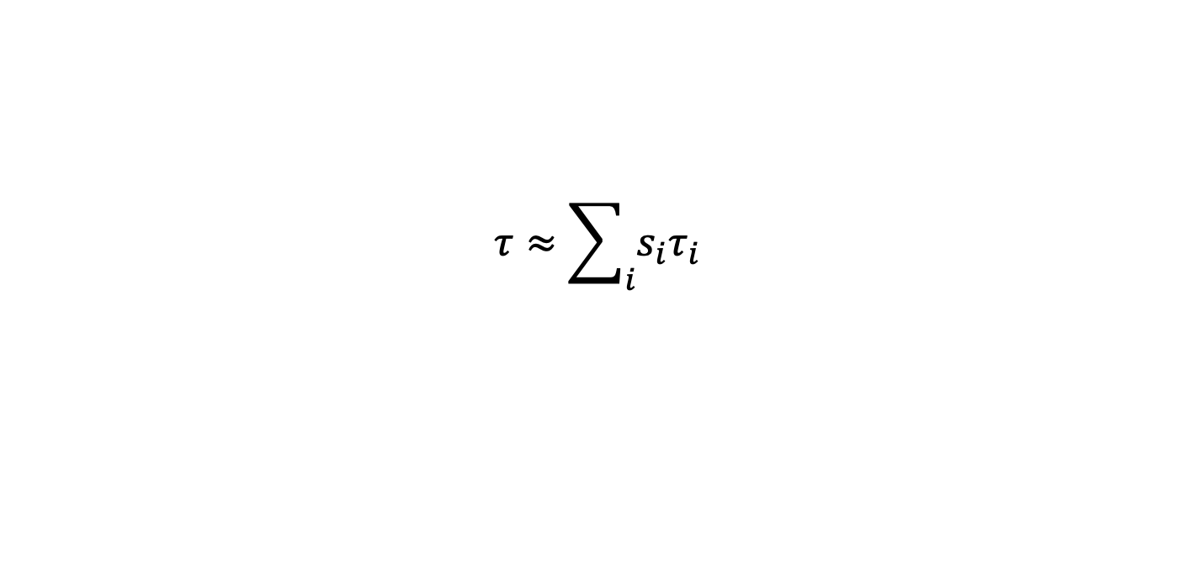
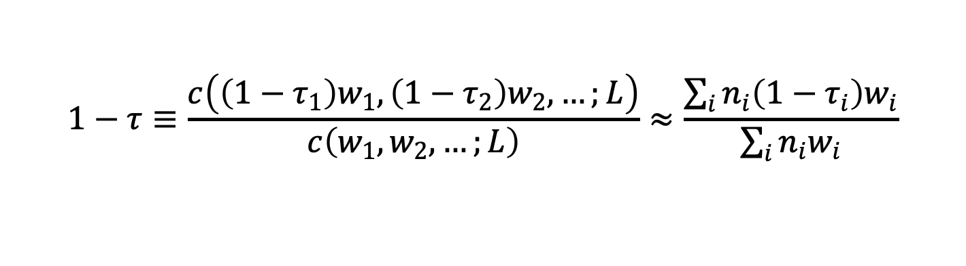
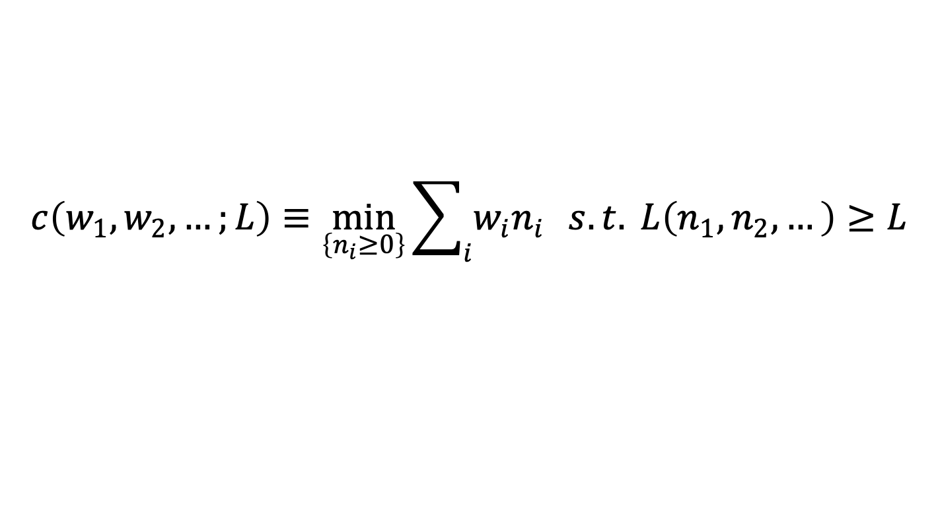
A cost function for wage aggregation
Aggregate production function (n’s are numbers of workers) $F\left(L\left(n_{1},n_{2},…\right),K\right)$
Employer cost
“Average marginal tax rate” is calculated as inflation is:
$$c\left(w_{1},w_{2},…;L\right)≡\min_{\left\{n_{i}≥0\right\}}{\sum_{i}{w_{i}n_{i}}} s.t. L\left(n_{1},n_{2},…\right)≥L$$
$$1−τ≡\frac{c\left(\left(1−τ_{1}\right)w_{1},\left(1−τ_{2}\right)w_{2},…;L\right)}{c\left(w_{1},w_{2},…;L\right)}≈\frac{\sum_{i}{n_{i}\left(1−τ_{i}\right)w_{i}}}{\sum_{i}{n_{i}w_{i}}}$$
$$τ≈\sum_{i}{s_{i}τ_{i}}$$

Slide 11
Budget Sets with Employment- and Income-tested Programs
disposable income
A
UI eligible
C
earnings during time interval
poverty threshold

Slide 13
Includes implicit taxes,
esp. employment taxes

Slide 15

Fallacy of the Heap
$$τ≈\sum_{i}{s_{i}τ_{i}}$$

Slide 16
Other tax-benefit distortions
Non-uniform tax rates distort the composition of employment
Examples
  Full-time employment taxes
  Marriage tax
Composition analysis: subcost functions by type (e.g., married vs. unmarried)

Slide 17
Marriage taxes
disposable income
A
earnings during time interval
Married POV

Slide 18
Marriage taxes
disposable income
A
Both HHs below POV
One HH below POV
Both HHs above POV
earnings during time interval
Primary earner POV
Secondary earner POV

Slide 19
Does Redistribution Increase Wages?

Slide 20

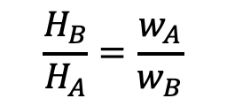

Chicago Price Theory, Figure I-5
“Nonmarket activity”
“Carpenter”
$$H_{B}$$
$$\frac{H_{B}}{H_{A}}=\frac{w_{A}}{w_{B}}$$
Pick B
Pick A
$$H_{A}$$
“Market work”
“Plumber”

Slide 21


Figure I-6: The opportunity set for selecting human capital
$$H_{B}$$
$$H_{A}$$

Slide 22

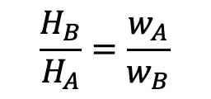

Figure I-7: Specialization
Short-run supply is less elastic than long run
What looks like a “wage” is often an income (quantity*price)
“Nonmarket activity”
$$H_{B}$$
$$\frac{H_{B}}{H_{A}}=\frac{w_{A}}{w_{B}}$$
Pick B
Pick A
$$H_{A}$$
“Market work”

Slide 23

“If people are withdrawing their labor, wages should rise; but in the late part of the twentieth century and into the twenty-first, wages fell along with employment, a clear indication that the problem lies with falling demand, not falling supply.”
p. 70

Slide 24
